Slide 1

Recommendation system
Group 6
Aman Bhargava
Parth Mau
Snigdha Rudola
Srabana Chaudhuri
Utkarsh Bajaj

Slide 2





Team Members
Aman Bhargava | Parth Mau | Srabana Chaudhuri | Snigdha Rudola | Utkarsh Bajaj
MS-BAIM | MS-BAIM | MEM | MS-BAIM | MS-BAIM

Slide 3

AGENDA
1. CASE OVERVIEW
2. DATASET OVERVIEW
3. CODE IMPLEMENTATION
4. PERTINENT QUESTIONS
4. FUTURE SCOPE

Slide 4


Case Overview
Every time when everyone wants to go out and meet, whether it’s friends or family, the debate to find the perfect restaurant to meet at rages on for a while.
With the use of this dataset, we aim to recommend restaurants as per a user’s preferences based on restaurants one has already reviewed. We could also provide feedback to the restaurants as per the customer inputs using Exploratory Data Analysis. The data set is made from user inputs from their previous visits to one or more of these restaurants.

Slide 5





DATASET OVERVIEW
138
Customers
130
Restaurants
Overall Rating
Food Rating
Service Rating

Slide 6
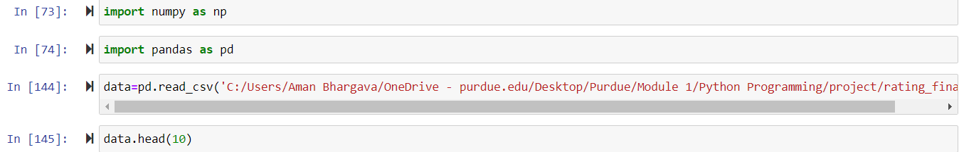
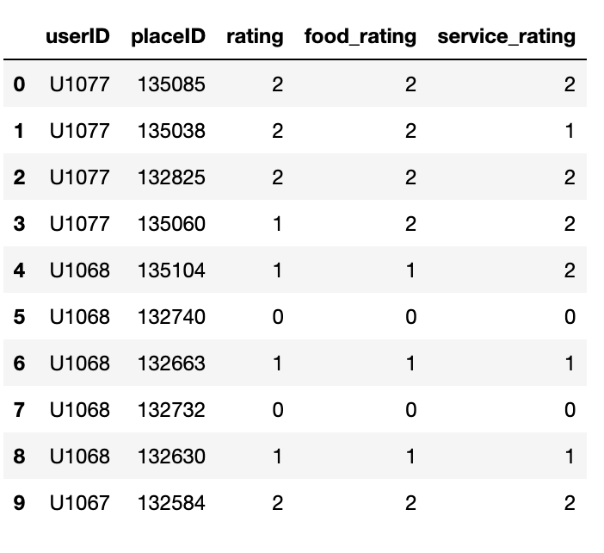
Importing libraries & READING THE FILE
Data columns explained
‘user ID’ : Unique ID given to each restaurant visitor
‘place ID’ : Unique ID given to each restaurant
‘rating’ : Overall rating given on a scale of 0 to 2 to a particular restaurant identified by placeID
‘food_rating’ : Rating given to a restaurant based on its food, on a scale of 0 to 2
‘service_rating’ : Rating given to a restaurant based on its service, on a scale of 0 to 2

Slide 7
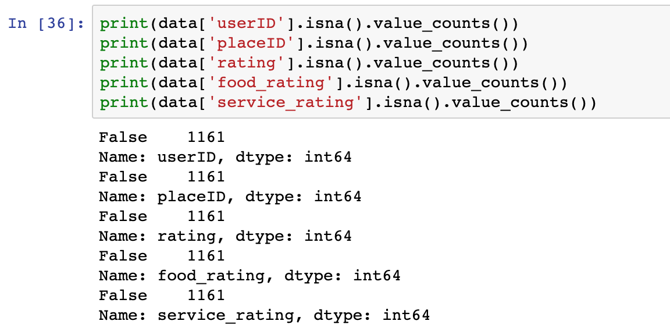
CHECKING FOR MISSING DATA
Our data did not have any missing values

Slide 8
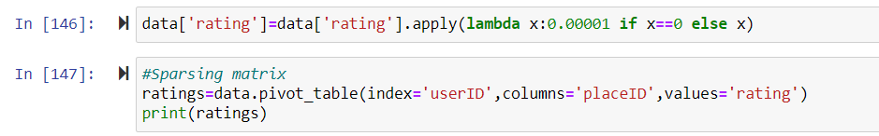
DISTINGUISHING NULLS (No Ratings) & '0' RATINGS

Slide 9
RECOMMENDATION SYSTEM DESIGN
Select user
Pearson’s Correlation
Find similarity between users
Determine a user’s set of neighbors
Generate weighted recommendation
User specific recommendation

Slide 10


Collaborative FILTERING
Restaurant liked by both
Among the many ways that recommendations can be produced, collaborative filtering tries to predict the rating a user would give to an item based on past preferences on other items and preferences of other users who are like him.
Our method – user based collaborative filtering
Restaurant liked by her,
Recommend to him

Slide 11
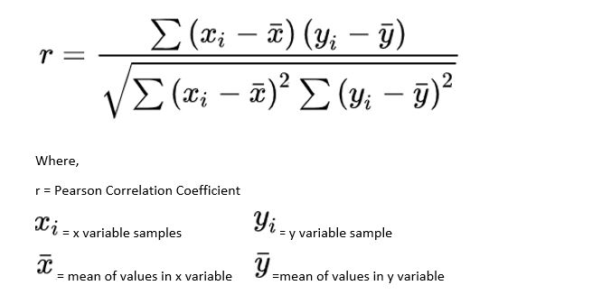
PEARSON’S CORRELATION
The Pearson correlation coefficient is used to measure the strength of a linear association between two variables, where the value r = 1 means a perfect positive correlation and the value r = -1 means a perfect negative correlation. Here, it is used to find the correlation between two users.

Slide 12
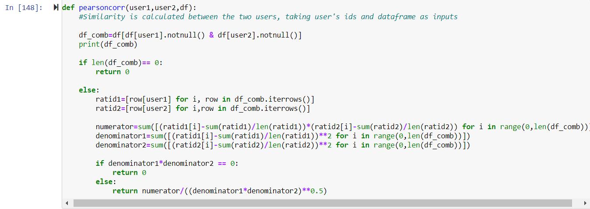
FIND SIMILARITY : ESTABLISHING CORRELATION BETWEEN USERS
A function is defined to find the similarity between two users

Slide 13
FIND SIMILARITY: Correlation output
Testing the correlation between 2 users

Slide 14
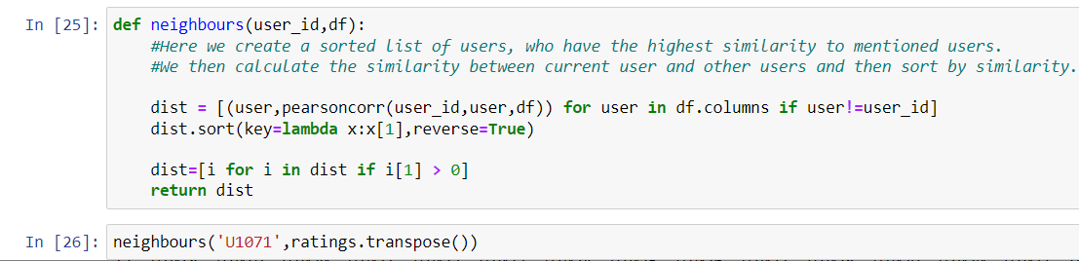
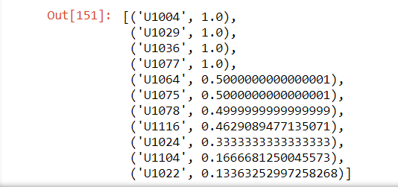
DEFINE NEIGHBOURS: SORTING USERS BY SIMILARITY
Users like the selected user are sorted in order of similarity to check common preferences

Slide 15
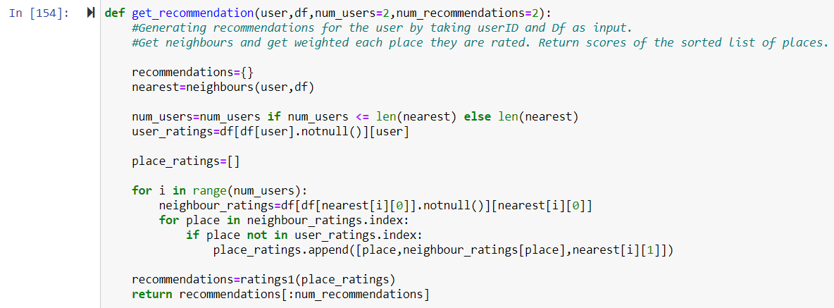
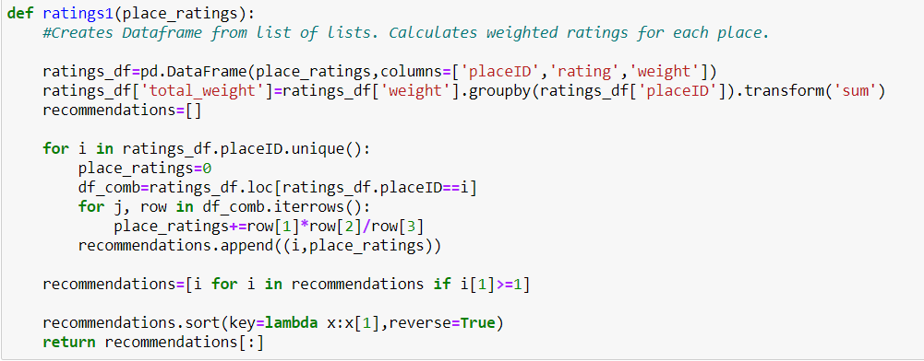
GENERATE RECOMMENDATIONS
A function is defined to generate restaurant recommendations based on the user

Slide 16
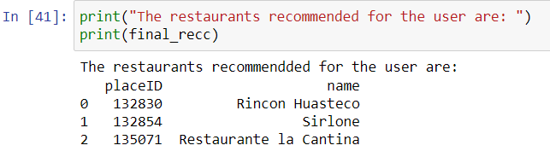
FINAL RECOMMENDATION
The final restaurant recommendations for user is generated as per the function defined

Slide 17
PERTINENT Questions
How frequently are the restaurants rated?
Which restaurants are highly liked, overall as well as for food?
What matters more to customers, when rating a restaurant?
What kind of cuisines are most popular?
What are the most visited restaurants?
What are the restaurants that are least rated overall. Are their ratings low on food , service or both?

Slide 18
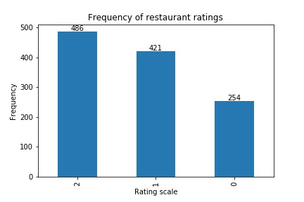
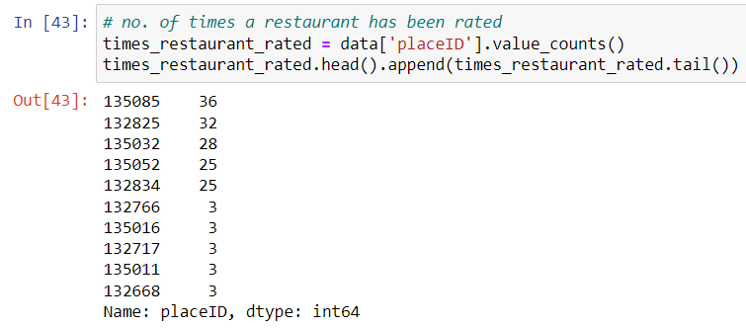
HOW FREQUENTLY ARE RESTAURANTS RATED?
Any restaurant has been rated at least by 3 customers and at most by 36 customers
Frequency Distribution

Slide 19
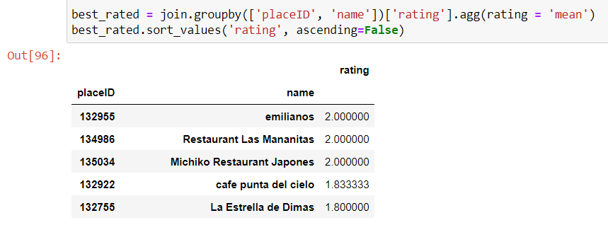
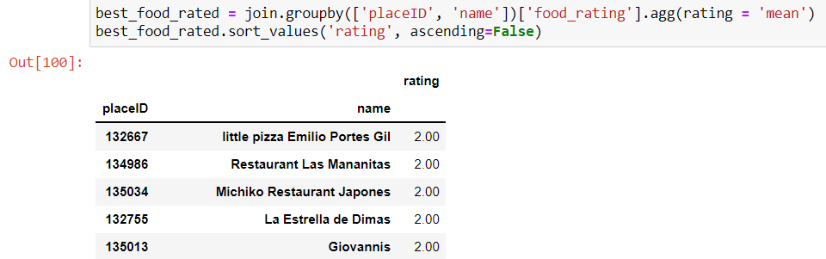
WHICH RESTAURANTS SCORE HIGH ON OVERALL RATINGS AND FOOD RATINGS?
Restaurants with best food ratings:
Little Pizza Emilio Portes Gil
Restaurant Las Mananitas
Michikio Restaurant Japones
La Estrella de Dimas
Giovannis
Restaurants with the best overall ratings:
Emilianos
Restaurant Las Mananitas
Michiko Restaurant Japones

Slide 20
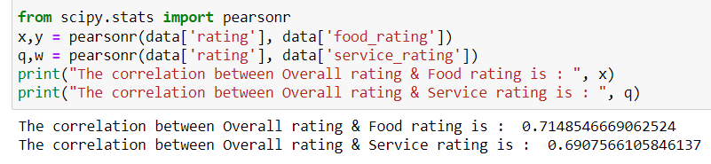
WHAT MATTERS MORE TO CUSTOMERS WHEN RATING A RESTAURANT?
Food and Service are almost equally important when it comes to customers rating the restaurant

Slide 21
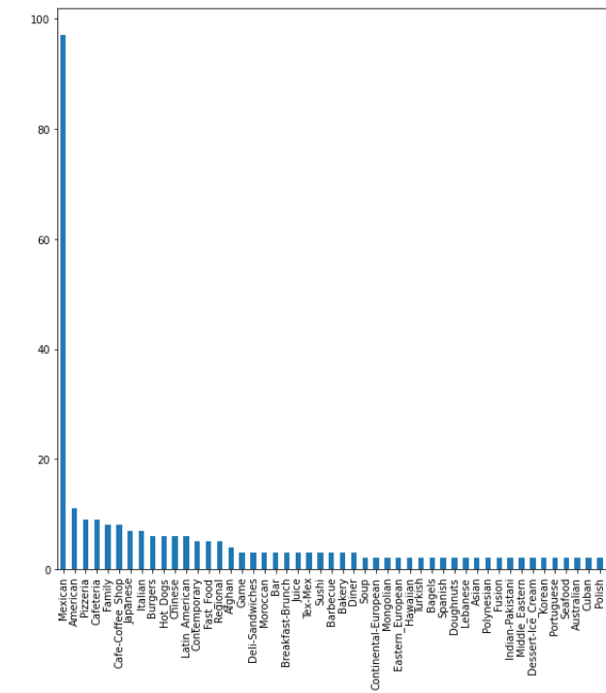
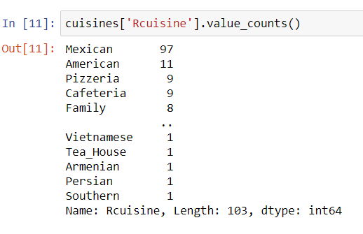
WHICH CUISINE DO OUR CUSTOMERS PREFER?
Mexican cuisine seems to be the most popular choice amongst customers

Slide 22
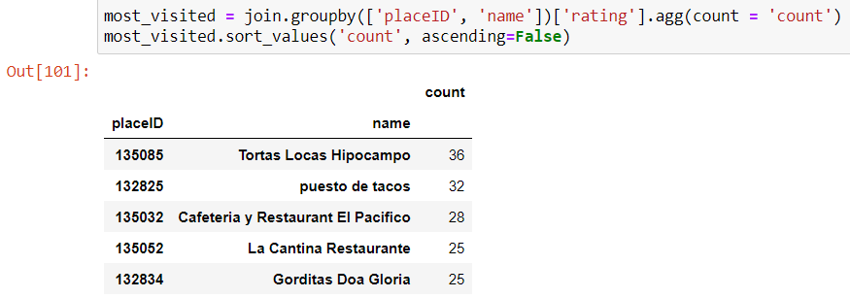
WHICH ARE THE MOST VISITED RESTAURANTS?
Most visited restaurants:
Tortas Locas Hipocampo
Puesto de Tacos
Cafeteria y Restaurant El Pacifico

Slide 23
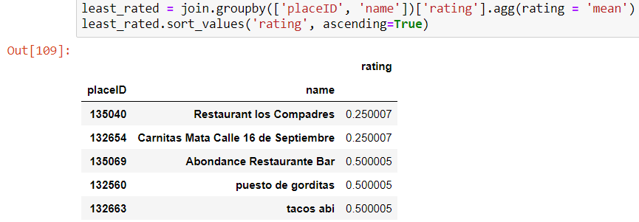
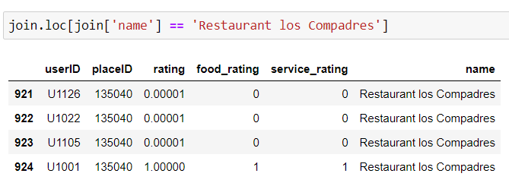
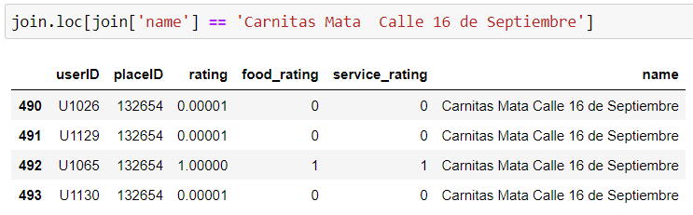
WHICH ARE THE RESTAURANTS THAT ARE LEAST RATED OVERALL?
2 restaurants that are least rated:
Restaurant los Compadres
Carnitas Mata Calle 16 de Septiembre
We notice that both food as well as service ratings have been mostly low for these two restaurants

Slide 24

FUTURE SCOPE
Potentially increase the precision of our recommendations, by implementing a model-based approach
All the recommendations are user specific, and all can be combined to create a real-time mobile application which will recommend users, restaurants on basis of their preferences and history
Similarly, similarity score of restaurants can be found as well making our recommendations even more precise
Parallelly, analysis of the data collected could prove to be very instrumental for the restaurants. This opportunity, of making this data along with our analysis available for them, could be monetized

Slide 25

Q&A

Slide 26

Thank you!

